Slide 1
Mental Health and Christianity by Tim A. Thrasher, LMSW

Slide 2
Mental Health and Christianity
Mental Illness does affect our ability to comprehend God’s plan by preventing rational/logical thought.
Mental illness does affect our ability to comprehend God’s plan by limiting our ability to process truth.
Mental illness at times causes us to be unable to realize the importance of faith in God.

Slide 3
Mental Health and Christianity-Suicide
We have to realize that individuals who commit suicide do so for a variety of reasons, through a variety of methods and only God understands their circumstances.
Let’s continue to love the families of those who have been affected by suicide. Being judgmental will not return their loved ones or encourage their spiritual well being.

Slide 4
Mental Health and Chrisitanity-Suicide
“Blessed are those who mourn, for they shall be comforted.
Matthew 5:4
Blessed be the God and Father of our Lord Jesus Christ, the Father of mercies and God of all comfort, who comforts us in all our affliction, so that we may be able to comfort those who are in any affliction, with the comfort with which we ourselves are comforted by God…
II Corinthians 1:3-4f

Slide 5
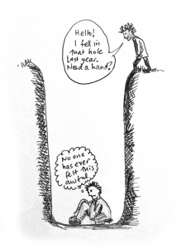
Mental Health and Christianity-Depression

Slide 6
Mental Health and Christianity-Depression
Lamentations 3-Depression
Symptoms
Affliction v. 1
Darkness without light v. 2
God is against him v. 3
Skin and flesh waste away-broken bones v. 4
Besieged and enveloped with bitterness and tribulation v. 5
Dwell as if dead- v. 6
Imprisoned-a wall about him v. 7
Prayer is not heard v. 8

Slide 7
Mental Health and Christianity-Depression
Lamentations 3
Ways out are blocked v. 9
Others are after him-bear lies in wait v. 10
Torn to pieces and desolate v. 11
I am targeted by the bow v. 12
People laugh at me v. 14
I worry and grieve v. 16
I have no peace within v. 17
Forgotten happiness v. 17
Lost hope in the Lord v. 18

Slide 8
Mental Health and Christianity-Depression

Slide 9
Mental Health and Christianity-Depression
Types of depression
Symptoms caused by major depression can vary from person to person. To clarify the type of depression you have, your doctor may add one or more specifiers. A specifier means that you have depression with specific features, such as:
Anxious distress — depression with unusual restlessness or worry about possible events or loss of control
Mixed features — simultaneous depression and mania, which includes elevated self-esteem, talking too much and increased energy

Slide 10
Mental Health and Christianity-Depression
Types of Depression:
Melancholic features — severe depression with lack of response to something that used to bring pleasure and associated with early morning awakening, worsened mood in the morning, major changes in appetite, and feelings of guilt, agitation or sluggishness
Atypical features — depression that includes the ability to temporarily be cheered by happy events, increased appetite, excessive need for sleep, sensitivity to rejection, and a heavy feeling in the arms or legs
Psychotic features — depression accompanied by delusions or hallucinations, which may involve personal inadequacy or other negative themes

Slide 11
Mental Health and Christianity-Depression
Types of Depression:
Catatonia — depression that includes motor activity that involves either uncontrollable and purposeless movement or fixed and inflexible posture
Peripartum onset — depression that occurs during pregnancy or in the weeks or months after delivery (postpartum)
Seasonal pattern — depression related to changes in seasons and reduced exposure to sunlight

Slide 12
Mental Health and Christianity-Depression
Other Disorders that cause depression symptoms:
Bipolar Disorder-mood disorder which includes mood swings ranging from high to low
Cyclothymic Disorder-Highs and lows milder than bipolar disorder
Disruptive mood dysregulation disorder-mood disorder in children includes severe irritability and anger with frequent extreme temper outbursts

Slide 13
Mental Health and Christianity-Depression
Other Disorders that cause depression symptoms:
Persistent depressive disorder-Dysthymia-less severe but more chronic-prevents normal functioning in your daily routine and living life fully
Premenstrual dysphoric disorder-depression symptoms associated with hormone changes related to a women’s cycle
Other dispressive disorders-depression caused by drugs or medical condition

Slide 14
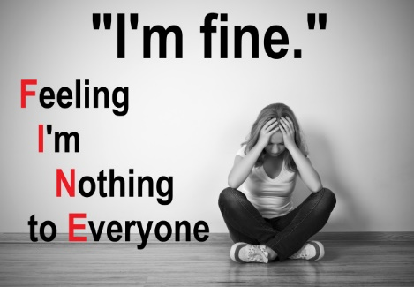
Mental Health and Christianity-Depression

Slide 15
Mental Health and Christianity-Depression
A mental health disorder characterized by persistently depressed mood or loss of interest in activities, causing significant impairment in daily life.
Very common
More than 3 million US cases per year

Slide 16
Mental Health and Christianity-Depression
Treatable by a medical professional
Possible causes include a combination of biological, psychological, and social sources of distress. Increasingly, research suggests these factors may cause changes in brain function, including altered activity of certain neural circuits in the brain.

Slide 17
Mental Health and Christianity-Depression
The persistent feeling of sadness or loss of interest that characterizes major depression can lead to a range of behavioral and physical symptoms. These may include changes in sleep, appetite, energy level, concentration, daily behavior, or self-esteem. Depression can also be associated with thoughts of suicide.
The mainstay of treatment is usually medication, talk therapy, or a combination of the two. Increasingly, research suggests these treatments may normalize brain changes associated with depression.

Slide 18
Mental Health and Christianity-Depression
People may experience:
Mood: anxiety, apathy, general discontent, guilt, hopelessness, loss of interest, loss of interest or pleasure in activities, mood swings, or sadness
Behavioral: agitation, excessive crying, irritability, restlessness, or social isolation
Sleep: early awakening, excess sleepiness, insomnia, or restless sleep
Whole body: excessive hunger, fatigue, or loss of appetite
Cognitive: lack of concentration, slowness in activity, or thoughts of suicide
Weight: weight gain or weight loss
Also common: poor appetite or repeatedly going over thoughts

Slide 19
Mental Health and Christianity-Depression
Treatment:
Medications and psychotherapy are effective for most people with depression. Your primary care doctor or psychiatrist can prescribe medications to relieve symptoms. However, many people with depression also benefit from seeing a psychiatrist, psychologist or other mental health professional.
If you have severe depression, you may need a hospital stay, or you may need to participate in an outpatient treatment program until your symptoms improve.

Slide 20
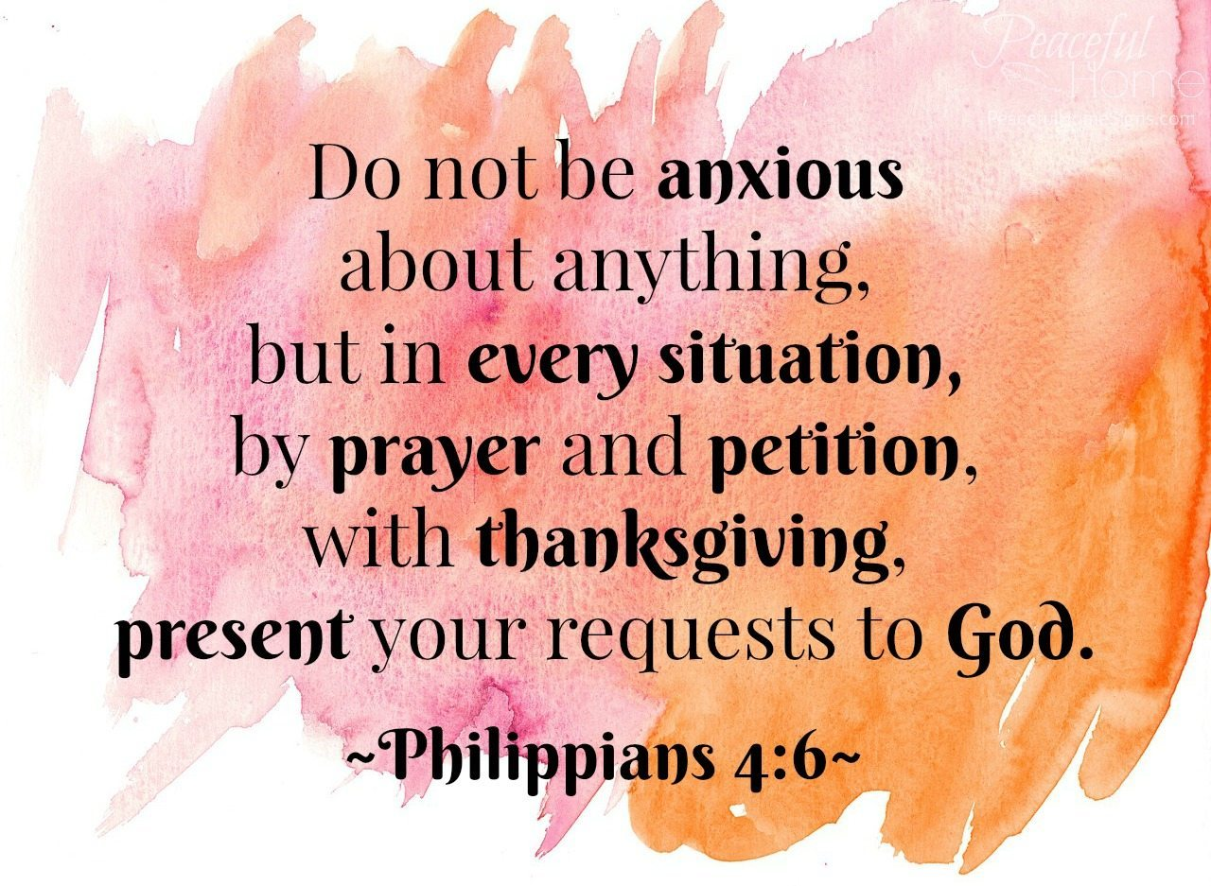
Mental Health and Christianity-Depression

Slide 21
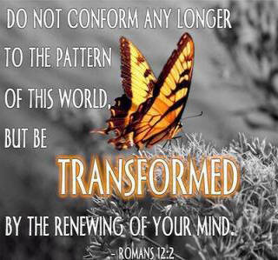
Mental Health and Christianity-Depression

Slide 22
Mental Health and Christianity-Depression
Mark 5: 1-20
Man with unclean spirit
Lived in tombs
Not able to be subdued
Crying out all the time
Cutting himself
Named Legion
For we are many

Slide 23
Mental Health and Christianity-Depression
Doctrines of Demons and Mental Health
"Don't let anyone capture you with empty philosophies and high-sounding nonsense that come from human thinking and from the spiritual powers of this world, rather than from Christ (Colossians 2:8 NLT).“
"O Timothy, guard what has been entrusted to you, avoiding worldly and empty chatter and the opposing arguments of what is falsely called 'knowledge'— which some have professed and thus gone astray from the faith (1 Timothy 6:20-21 NASB)."

Slide 24
Mental Health and Christianity
Doctrines of Demons and Mental Health
""Now the Spirit expressly says that in latter times some will depart from the faith, giving heed to deceiving spirits and doctrines of demons . . . (1 Timothy 4:1 NKJV).“
Doctrines of demons are evident in many facets of society. But nowhere are they more obvious than in the "science" of psychology and the field of mental health care.

Slide 25
Mental Health and Christianity-Depression
James 3: 13-18 Who is wise and understanding among you? By his good conduct let him show his works in the meekness of wisdom. But if you have bitter jealousy and selfish ambition in your hearts, do not boast and be false to the truth. This is not the wisdom that comes down from above, but is earthly, unspiritual, demonic. For where jealousy and selfish ambition exist, there will be disorder and every vile practice. But the wisdom from above is first pure, then peaceable, gentle, open to reason, full of mercy and good fruits, impartial and sincere. And a harvest of righteousness is sown in peace by those who make peace.

Slide 26
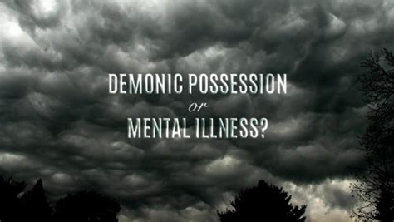
Mental Health and Christianity-Depression

Slide 27
Mental Health and Christianity-Depression
Belief in demons and evil spirits is linked to poorer mental health, according to research published in the Journal for the Scientific Study of Religion.
The study used data from 3,290 Americans who participated in the National Study of Youth and Religion to uncover that the belief in demons was a strong predictor of poorer mental health among youth and young adults. However, poorer mental health did not lead to greater belief in demons.

Slide 28
Mental Health and Christianity-Depression
The more young people believed in demons in their teens, the more likely they were as young adults to report feelings of being unloved or sad and depressed, researchers found.
Yet contrary to conventional wisdom, the reverse was not the case. Having poor mental health did not lead to greater belief in demonic forces.
“Mental health has no apparent, statistically significant effect on later changes in beliefs in demons,” researchers reported in the study results just published online in the Journal for the Society of the Scientific Study of Religion.

Slide 29
Mental Health and Christianity-Depression
When the response is dysfunctional, such as when the fear is disproportionate to the threat, it can lead to increased stress and attitudes of cynicism, distrust and hopelessness. These, in turn, are related to mental health ills such as depression, social anxiety, paranoia, obsessive compulsive disorder, and general anxiety.
In the case of religion, if one holds an excessive belief that demons with evil intentions are all around, it may be difficult to ever feel safe and secure.

Slide 30
Mental Health and Christianity-Depression
“It may be,” Nie and Olson wrote, “that views of the world in which life is perceived to be unpredictable, out of control, or worse yet, controlled by malevolent forces, have the potential to be far more damaging to mental health ... than the possible protective effects of reassuring beliefs.”
The findings in the Purdue study are also consistent with a developing body of research on the dark side of religion, when fear and judgment unbalanced by a sense of divine love and mercy can take a substantial toll on health.

