Slide 1
Mental Health and Christianity by Tim A. Thrasher, LMSW

Slide 2
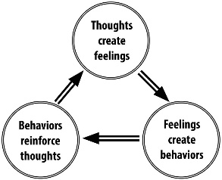
Mental Health and Christianity
“For as a man thinks in his heart (mind), so is he.” Proverbs 23:7

Slide 3
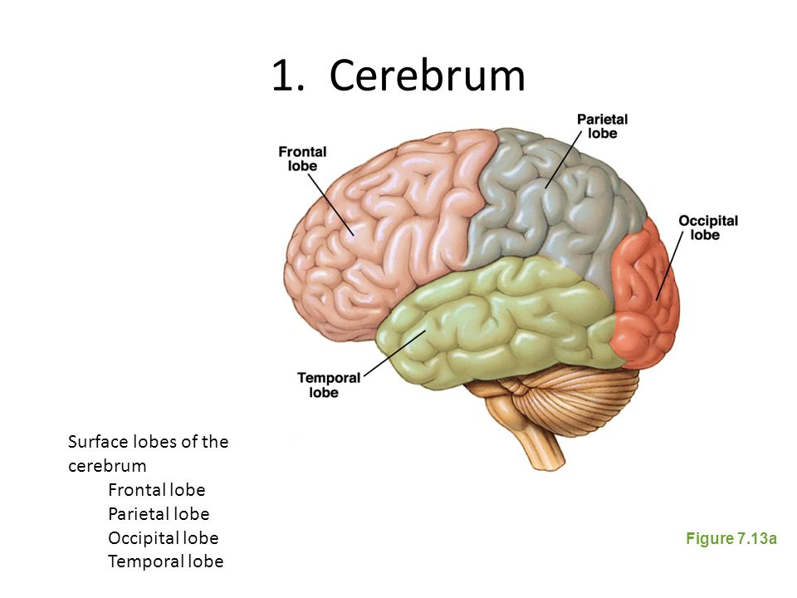
Mental Health and Christianity

Slide 4
Mental Health and Christianity
Complex brain structure is designed by God
Areas where we are most vulnerable are positioned for protection by God. Brain stem is at lower back part of brain and along with the Medulla Oblongata protects the heart beat, digestion and breathing.

Slide 5
Mental Health and Christianity
Brain halves have distinct traits which work together based on our building bridges within the brain. As mother’s rock their children the brains hemispheres are joined with synapses.
Medication can be used to alter brain function when the part of the brain is not working effectively due to mental illness.
Environment has an intense effect on our brain and its mental health.

Slide 6
Mental Health and Christianity
The Great Commandment
³⁴ But when the Pharisees heard that he had silenced the Sadducees, they gathered together. ³⁵ And one of them, a lawyer, asked him a question to test him. ³⁶ “Teacher, which is the great commandment in the Law?” ³⁷ And he said to him, “You shall love the Lord your God with all your heart and with all your soul and with all your mind. ³⁸ This is the great and first commandment. ³⁹ And a second is like it: You shall love your neighbor as yourself. ⁴⁰ On these two commandments depend all the Law and the Prophets.”

Slide 7
Mental Health and Christianity
1Corinthians 2: 12-16
Now we have received not the spirit of the world, but the Spirit who is from God, that we might understand the things freely given us by God. And we impart this in words not taught by human wisdom but taught by the Spirit, interpreting spiritual truths to those who are spiritual.
The natural person does not accept the things of the Spirit of God, for they are folly to him, and he is not able to understand them because they are spiritually discerned. The spiritual person judges all things, but is himself to be judged by no one. “For who has understood the mind of the Lord so as to instruct him?” But we have the mind of Christ.

Slide 8
Mental Health and Christianity
Mental Illness does affect our ability to comprehend God’s plan by preventing rational/logical thought.
Mental illness does affect our ability to comprehend God’s plan by limiting our ability to process truth.
Mental illness at times causes us to be unable to realize the importance of faith in God.

Slide 9
Mental Health and Christianity
Mental illness discussion topics:
Anxiety/Depression
Autism Spectrum
ADHD
OCD
Intellectual Development
Suicide
Substance Abuse

Slide 10
Mental Health and Christianity-Suicide Facts
Suicide is the 10th leading cause of death in the US for all ages. (CDC)
Every day, approximately 123 Americans die by suicide. (CDC)
There is one death by suicide in the US every 12 minutes. (CDC)
Depression affects 20-25% of Americans ages 18+ in a given year. (CDC)
Suicide takes the lives of over 44,965 Americans every year. (CDC)
The highest suicide rates in the US are among Whites, American Indians and Alaska Natives.
Only half of all Americans experiencing an episode of major depression receive treatment. (NAMI)

Slide 11
Mental Health and Christianity-Suicide Facts
80% -90% of people that seek treatment for depression are treated successfully using therapy and/or medication. (TADS study)
An estimated quarter million people each year become suicide survivors (AAS).
There is one suicide for every estimated 25 suicide attempts. (CDC)
There is one suicide for every estimated 4 suicide attempts in the elderly. (CDC)

Slide 12
Mental Health and Christianity
Suicide among males is 4x’s higher than among females. Male deaths represent 79% of all US suicides. (CDC)
Firearms are the most commonly used method of suicide among males (51%). (CDC)
Females are more likely than males to have had suicidal thoughts. (CDC)
Females experience depression at roughly 2x’s the rate of men.(SMH)
Females attempt suicide 3x’s as often as males. (CDC)
Poisoning is the most common method of suicide for females. (CDC)

Slide 13
Mental Health and Christianity
1 in 100,000 children ages 10 to 14 die by suicide each year. (NIMH)
7 in 100,000 youth ages 15 to 19 die by suicide each year. (NIMH)
12.7 in 100,000 young adults ages 20-24 die by suicide each year. (NIMH)
The prevalence of suicidal thoughts, suicidal planning and suicide attempts is significantly higher among adults aged 18-29 than among adults aged 30+. (CDC)
Suicide is the 3rd leading cause of death for 15 to 24 year old Americans. (CDC)

Slide 14
Mental Health and Christianity
Suicide is the 4th leading cause of death for adults ages 18-65. (CDC)
The highest increase in suicide is in males 50+ (30 per 100,000). (CDC)
Suicide rates for females are highest among those aged 45-54 (9 per 100,000). (CDC)
Suicide rates for males are highest among those aged 75+ (36 per 100,000). (CDC)
Suicide rates among the elderly are highest for those who are divorced or widowed. (SMH)

Slide 15
Mental Health and Christianity
Nearly 800,000 people die by suicide in the world each year, which is roughly one death every 40 seconds.
Suicide is the 2nd leading cause of death in the world for those aged 15-24 years.
Depression is the leading cause of disability worldwide.

Slide 16
Mental Health and Christianity
Lamar Steiger’s Story
Background Motive
Means Plan
Sarah Jane Shield’s Story
Background Motive
Means Plan

Slide 17
Mental Health and Christianity-Suicide
Abimelech-Judges 9:54-sword-wounded by a woman-pride
Ruled 3 years as King-son of Gideon
Murdered all but one of the sons of his father (70 sons) at the family’s home town of Ophrah
Jotham, the youngest, escaped
Abimelech-was wounded to death by a millstone dropped from a wall by a woman
To avoid the same of death at the hands of a woman he ordered his armor-bearer to kill him with his sword.

Slide 18
Mental Health and Christianity-Suicide
Samson-Judges 16: 29-31-crushed by a building-sacrificed his own life to kill Phillistines-justification
Was the last of the Israelite judges
Nazarite-given great strength by God
Killed a lion with his bear hands-slew an entire Philistine army with a jawbone of a donkey
Delilah betrayed him by cutting his hair and removing his strength
Had his eyes gouged out and was forced to grind grain at a mill at Gaza
In the temple of Dagon, Samson prayed for strength and then tore down the pillars and collapsed the temple killing himself and all the Philistines

Slide 19
Mental Health and Christianity-Suicide
Saul and his Armor Bearer-I Samuel 31: 3-6-Sword-grief and depression
1st King of Israel
Head and Shoulders above the rest
Disobeyed God
Fits of rage toward David
Died in battle by his own sword after being wounded by archers and his armor bearer refused to take his life
Saul, his armor bearer and his 3 sons died that day

Slide 20
Mental Health and Christianity-Suicide
Ahithophel-II Samuel 17:23-hanging-disgraced by Absalom
Counselor of King David
Joined Absalom in his revolt against David
After the revolt failed due to his advice not being taken
He left Absalom’s camp and returned to Giloh
Arranged his affairs
Hanged himself

Slide 21
Mental Health and Christianity-Suicide
Zimri-I Kings 16:18-Fire-didn’t want to be captured
Chariot commander who murdered Elah
Zimri succeeded Elah as King
Zimri reigned 7 days because the army elected Omri king and laid siege on Tirzah
Zimri set fire to the palace-killing himself

Slide 22
Mental Health and Christianity-Suicide
Judas-Matthew 27:5-hanging-due to remorse of betraying Jesus
One of the original apostles selected by Jesus
Betrayed Jesus for 30 pieces of silver with a kiss in the Garden of Gethsemane
Betrayal predicted at last supper
Tried to return the silver to the chief priests
Committed suicide by hanging

Slide 23
Mental Health and Chrisitanity-Suicide
Again I saw all the oppressions that are done under the sun. And behold, the tears of the oppressed, and they had no one to comfort them! On the side of their oppressors there was power, and there was no one to comfort them. And I thought the dead who are already dead more fortunate than the living who are still alive. But better than both is he who has not yet been and has not seen the evil deeds that are done under the sun.
Ecclesiastes 4:1-3

Slide 24
Mental Health and Christianity-Suicide
If you were in the twin towers and couldn’t get out what would you have done?
We have to realize that individuals who commit suicide do so for a variety of reasons, through a variety of methods and only God understands their circumstances.
Let’s continue to love the families of those who have been affected by suicide. Being judgmental will not return their loved ones or encourage their spiritual well being.

Slide 25
Mental Health and Chrisitanity-Suicide
“Blessed are those who mourn, for they shall be comforted.
Matthew 5:4
Blessed be the God and Father of our Lord Jesus Christ, the Father of mercies and God of all comfort, who comforts us in all our affliction, so that we may be able to comfort those who are in any affliction, with the comfort with which we ourselves are comforted by God…
II Corinthians 1:3-4f

