Slide 1
Mental Health and Christianity by Tim A. Thrasher, LMSW

Slide 2
Mental Health and Christianity
Mental Illness does affect our ability to comprehend God’s plan by preventing rational/logical thought.
Mental illness does affect our ability to comprehend God’s plan by limiting our ability to process truth.
Mental illness at times causes us to be unable to realize the importance of faith in God.

Slide 3
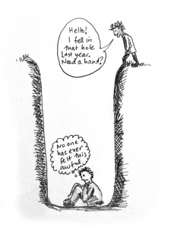
Mental Health and Christianity-Depression

Slide 4
Mental Health and Christianity-Depression
Lamentations 3-Depression
Symptoms
Affliction v. 1
Darkness without light v. 2
God is against him v. 3
Skin and flesh waste away-broken bones v. 4
Besieged and enveloped with bitterness and tribulation v. 5
Dwell as if dead- v. 6
Imprisoned-a wall about him v. 7
Prayer is not heard v. 8

Slide 5
Mental Health and Christianity-Depression
Lamentations 3
Ways out are blocked v. 9
Others are after him-bear lies in wait v. 10
Torn to pieces and desolate v. 11
I am targeted by the bow v. 12
People laugh at me v. 14
I worry and grieve v. 16
I have no peace within v. 17
Forgotten happiness v. 17
Lost hope in the Lord v. 18

Slide 6
Mental Health and Christianity-Depression

Slide 7
Mental Health and Christianity-Depression
A mental health disorder characterized by persistently depressed mood or loss of interest in activities, causing significant impairment in daily life.
Very common
More than 3 million US cases per year

Slide 8
Mental Health and Christianity-Depression
Treatable by a medical professional
Possible causes include a combination of biological, psychological, and social sources of distress. Increasingly, research suggests these factors may cause changes in brain function, including altered activity of certain neural circuits in the brain.

Slide 9
Mental Health and Christianity-Depression
The persistent feeling of sadness or loss of interest that characterizes major depression can lead to a range of behavioral and physical symptoms. These may include changes in sleep, appetite, energy level, concentration, daily behavior, or self-esteem. Depression can also be associated with thoughts of suicide.
The mainstay of treatment is usually medication, talk therapy, or a combination of the two. Increasingly, research suggests these treatments may normalize brain changes associated with depression.

Slide 10
Mental Health and Christianity-Depression
People may experience:
Mood: anxiety, apathy, general discontent, guilt, hopelessness, loss of interest, loss of interest or pleasure in activities, mood swings, or sadness
Behavioral: agitation, excessive crying, irritability, restlessness, or social isolation
Sleep: early awakening, excess sleepiness, insomnia, or restless sleep
Whole body: excessive hunger, fatigue, or loss of appetite
Cognitive: lack of concentration, slowness in activity, or thoughts of suicide
Weight: weight gain or weight loss
Also common: poor appetite or repeatedly going over thoughts

Slide 11
Mental Health and Christianity-Depression
Treatment:
Medications and psychotherapy are effective for most people with depression. Your primary care doctor or psychiatrist can prescribe medications to relieve symptoms. However, many people with depression also benefit from seeing a psychiatrist, psychologist or other mental health professional.
If you have severe depression, you may need a hospital stay, or you may need to participate in an outpatient treatment program until your symptoms improve.

Slide 12
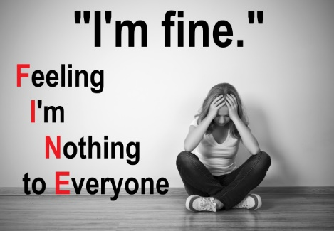
Mental Health and Christianity-Depression

Slide 13
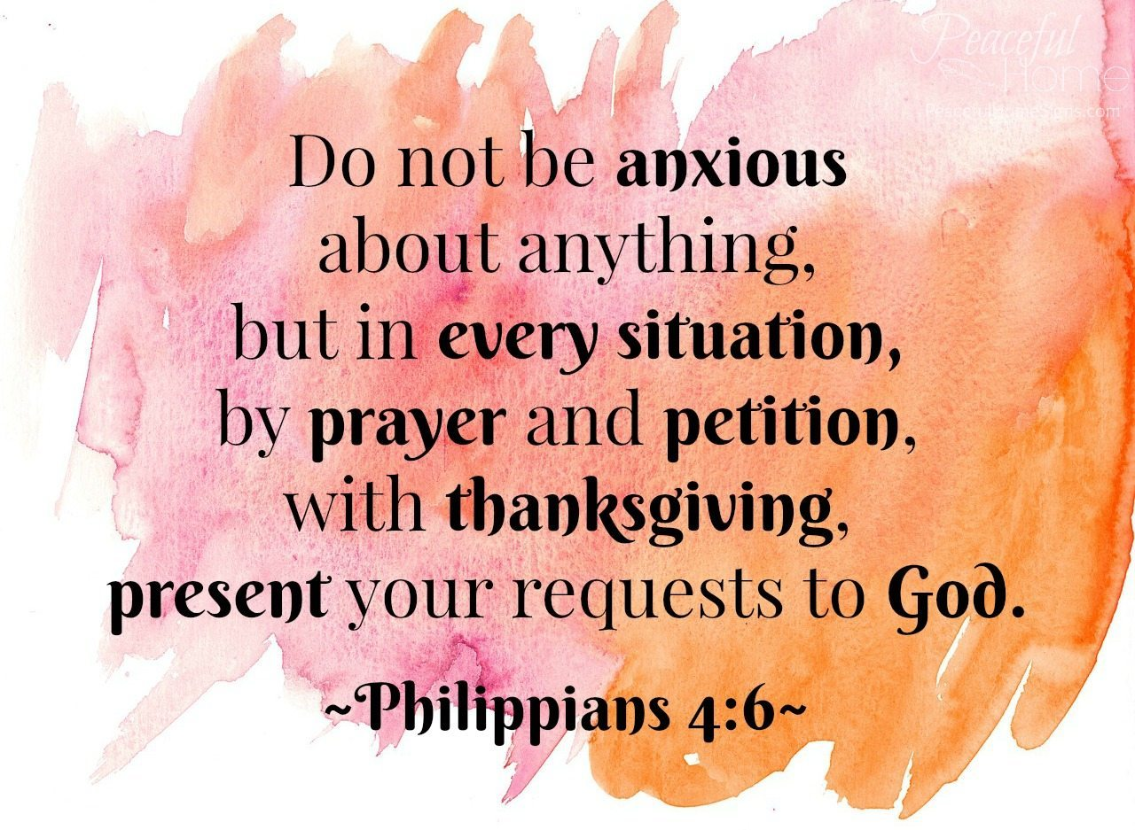
Mental Health and Christianity-Depression

Slide 14
Mental Health and Christianity-Depression

Slide 15
Mental Health and Christianity-Depression
Mark 5: 1-20
Man with unclean spirit
Lived in tombs
Not able to be subdued
Crying out all the time
Cutting himself
Named Legion
For we are many

Slide 16
Mental Health and Christianity
Doctrines of Demons and Mental Health
""Now the Spirit expressly says that in latter times some will depart from the faith, giving heed to deceiving spirits and doctrines of demons . . . (1 Timothy 4:1 NKJV).“
Doctrines of demons are evident in many facets of society. But nowhere are they more obvious than in the "science" of psychology and the field of mental health care.

Slide 17
Mental Health and Christianity-Depression
James 3: 13-18 Who is wise and understanding among you? By his good conduct let him show his works in the meekness of wisdom. But if you have bitter jealousy and selfish ambition in your hearts, do not boast and be false to the truth. This is not the wisdom that comes down from above, but is earthly, unspiritual, demonic. For where jealousy and selfish ambition exist, there will be disorder and every vile practice. But the wisdom from above is first pure, then peaceable, gentle, open to reason, full of mercy and good fruits, impartial and sincere. And a harvest of righteousness is sown in peace by those who make peace.

Slide 18
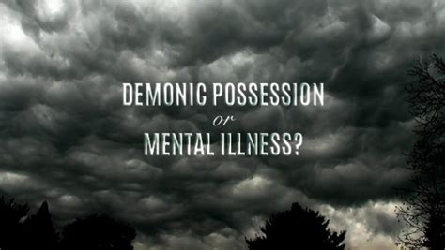
Mental Health and Christianity-Depression

Slide 19
Mental Health and Christianity-Depression
Belief in demons and evil spirits is linked to poorer mental health, according to research published in the Journal for the Scientific Study of Religion.
The study used data from 3,290 Americans who participated in the National Study of Youth and Religion to uncover that the belief in demons was a strong predictor of poorer mental health among youth and young adults. However, poorer mental health did not lead to greater belief in demons.

Slide 20
Mental Health and Christianity-Depression
The more young people believed in demons in their teens, the more likely they were as young adults to report feelings of being unloved or sad and depressed, researchers found.
Yet contrary to conventional wisdom, the reverse was not the case. Having poor mental health did not lead to greater belief in demonic forces.
“Mental health has no apparent, statistically significant effect on later changes in beliefs in demons,” researchers reported in the study results just published online in the Journal for the Society of the Scientific Study of Religion.

Slide 21
Mental Health and Christianity-Depression
When the response is dysfunctional, such as when the fear is disproportionate to the threat, it can lead to increased stress and attitudes of cynicism, distrust and hopelessness. These, in turn, are related to mental health ills such as depression, social anxiety, paranoia, obsessive compulsive disorder, and general anxiety.
In the case of religion, if one holds an excessive belief that demons with evil intentions are all around, it may be difficult to ever feel safe and secure.

Slide 22
Mental Health and Christianity-Depression
“It may be,” Nie and Olson wrote, “that views of the world in which life is perceived to be unpredictable, out of control, or worse yet, controlled by malevolent forces, have the potential to be far more damaging to mental health ... than the possible protective effects of reassuring beliefs.”
The findings in the Purdue study are also consistent with a developing body of research on the dark side of religion, when fear and judgment unbalanced by a sense of divine love and mercy can take a substantial toll on health.

Slide 23
Mental Health and Christianity
So how can we as a Church address mental illness?
1. Do Not Judge.
Judgement, and even well-intended religious statements (“You just need to pray more.”), will further isolate those with mental illness and potentially exacerbate their struggles. Try meeting these individuals with compassion and a listening ear. Church leaders do not need all the answers in order to be supportive. “More listening, less talking” is a good motto.

Slide 24
Mental Health and Christianity
2. Read and Research
Although most church leaders are not in a position to treat mental illness, they do need to have basic knowledge of mental health disorders and diseases. Why? Many struggling individuals may first seek help among their church leaders. It is important to recognize when church members’ struggles are related to mental health issues so that church leadership can help them find adequate support and treatment.

Slide 25
Mental Health and Christianity
3. Refer Out
Church leaders are not typically trained to treat mental illness; it is simply not their job. When church members demonstrate mental health issues, leaders should offer compassion and support, but also provide them with proper referrals for treatment. Generate a referral list and utilize when needed.

Slide 26
Mental Health and Christianity
4. Stop the Stigma
Stigma regarding mental illness still exists in both our country and our churches. As church leaders, there are simple ways to help reduce that stigma, including:
Avoid offensive language (i.e. words and phrases involving psycho, crazy, they are nuts, etc.).
Discuss mental health issues from the pulpit and in leadership meetings.
Use the church bulletin to feature mental health topics and supportive resources.
Acknowledge that mental health issues are complex in nature and involve biological, psychological, developmental, societal, spiritual, and familial components.

Slide 27
Mental Health and Christianity
5. Recognize Complexity
Although I believe all diseases and disorders are a result of humanity’s fall, I do not believe all diseases and disorders are direct results from one’s own sinful nature. To categorize mental illness as simply a spiritual issue is to ignore the beautiful complexity of which we are designed. Mental health issues are typically a combination of psychological, biological, developmental, societal, spiritual, and familial issues. Infant depression, schizophrenia, and Autism Spectrum Disorders are great examples of complex mental health issues.

Slide 28
Mental Health and Christianity
6. Understand the Impact on Family and Friends
Not all victims of mental illness are individuals with a diagnosable condition. Family and friends of individuals with mental illness often struggle with helping their loved one. Be careful what you say, offer support, and pray for them too.

Slide 29
Mental Health and Christianity
7. Care for Personal Mental Health
Last, but certainly not least, church leaders should take care of their own mental health. Leading a church can be a stressful position, and stress alone can lead to physical and mental deterioration. Church leaders should have adequate support, take time to relax, and reach out for support if they are struggling. Remember, it is okay to say “no” to requests for additional work. If church leaders are suffering, so will their ministries.

Slide 30
Mental Health and Christianity
8. Talk about it.
Every year, more than 25 percent of the U.S. adult population suffers from a diagnosable mental illness—mostly quietly and in shame.

Slide 31
Mental Health and Christianity
9. Assemble a network
Before a crisis, find professionals with a variety of specialties. Build relationships with them, ask for advice, and be ready to partner when someone needs care.

Slide 32
Mental Health and Christianity
10. Foster friendships
People affected by mental illness need friends who will not abandon them when they’re symptomatic.

Slide 33
Mental Health and Christianity
11.Walk through treatment
Visit the hospital. Bring casseroles. Help with the cost of medications. Ask how treatments are going. Minister to people with mental illness in the ways you minister to people recovering from surgery or enduring cancer treatments.

Slide 34
Mental Health and Christianity
My family has always been in the church. Dad was a pastor for 10 years. When schizophrenia came knocking, we were steeped in church life, yet the church was mostly silent on the reality of mental illness—and we got the message that we should be silent as well. This silence was isolating and cruel.
Yet our greatest moments of hope have come through encounters with individuals in the church who have made eye contact, visited Mom in prison, answered late-night phone calls to help her sort through her thoughts, showed up for small group when Dad cried every week. These are simple acts of love that reflect the heart of our creator, who knows far more than we do about how wretched we all are.

Slide 35
Mental Health and Christianity
Like it or not, the church is the first place many turn in crisis. And fair or not, the church’s silence or rejection feels like rejection from God. We cannot keep turning away from the most vulnerable among us. It’s time to be part of the solution.

